Slide 1


Department of Electronics and Communication Engineering
VLSI Design
COURSE CODE
Topic:
MOS Device analysis
(Threshold Voltage) and Electrical Properties
Session - 6

Slide 2



AIM OF THE SESSION
To familiarize students with aspects of MOS Transistors Threshold Voltage and electrical properties of MOS Transistors.
INSTRUCTIONAL OBJECTIVES
This Session is designed to:
Discuss the aspects of MOS Transistors threshold voltage.
Describe the electrical properties of MOS and Bi-MOS transistors.
LEARNING OUTCOMES
At the end of this session, you should be able to:
Discuss the aspects of threshold in MOS transistors.
Discuss the electrical properties of MOS Transistors and BiMOS Transistors.
Summarize all the important aspects of MOS Transistor Threshold Voltage V_{t}.

Slide 3
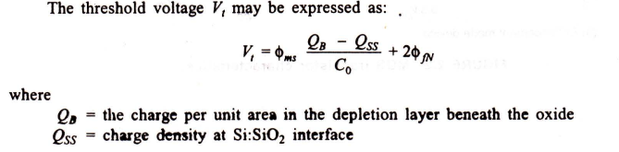
Aspects of MOS Transistor THRESHOLD VOLTAGE Vt
The gate structure of a MOS transistor consists, electrically, of charges stored in the dielectric layers.
In the surface-to-surface interfaces as well as in the substrate itself.
Switching an enhancement mode MOS transistor from the off to the on state consists
in applying sufficient gate voltage to neutralize these charges and
enable the underlying silicon to undergo an inversion due to the electric field from the gate.
Switching a depletion mode nMOS transistor from the on to the off state consists
in applying enough voltage to the gate to add to the stored charge and invert the 'n' implant region to 'p'.

Slide 4

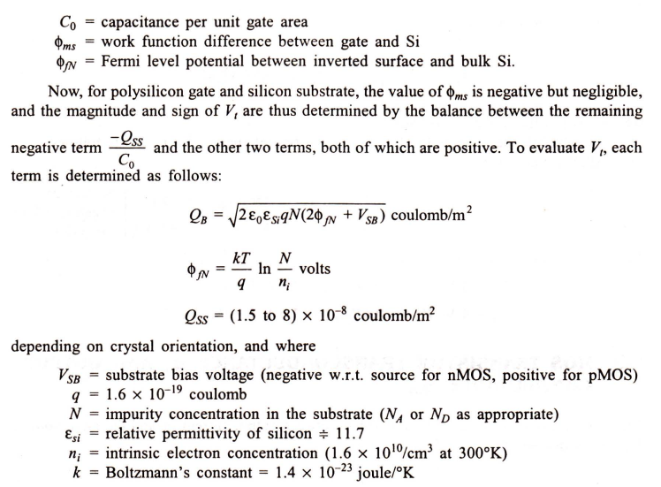
Aspects of MOS Transistor THRESHOLD VOLTAGE Vt

Slide 5
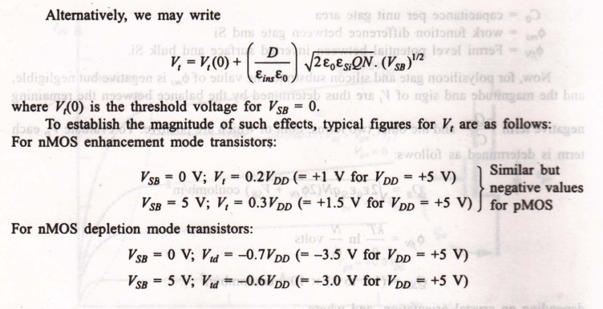
Aspects of MOS Transistor THRESHOLD VOLTAGE Vt

Slide 6
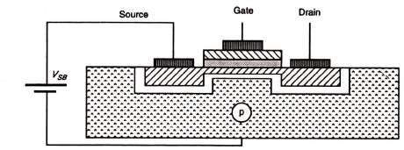
Basic Electrical Properties of MOS and Bi CMOS circuits
Body Effect
Generally while studying the MOS transistors it is treated as a three terminal device.
But, the body of the transistor is also an implicit terminal
which helps to understand the characteristics of the transistor.
Considering the body of the MOS transistor as a terminal is known as the body effect.
The potential difference between the source and the body (V_{sb}) affects the threshold voltage of the transistor.
In many situations,
this Body Effect is relatively insignificant, so we can (unless otherwise stated) ignore the Body Effect.
But it is not always insignificant,
in some cases it can have a tremendous impact on MOSFET circuit performance.

Slide 7

Basic Electrical Properties of MOS and Bi CMOS circuits
Body Effect
Increasing Vsb causes the channel to be depleted of charge carriers and
Thus, the threshold voltage is raised.
Change in Vt is given by ΔVt = γ.(Vsb)1/2
where γ is a constant which depends on substrate doping
so that the more lightly doped the substrate, the smaller will be the body effect
The threshold voltage can be written as
Where Vt(0) is the threshold voltage for Vsd = 0
For n-MOS depletion mode transistors ,the body voltage values at different VDD voltages are given below.
VSB = 0 V ; Vsd = -0.7VDD (= - 3.5 V for VDD =+5V )
VSB = 5 V ; Vsd = -0.6VDD (= - 3.0 V for VDD =+5V )

Slide 8
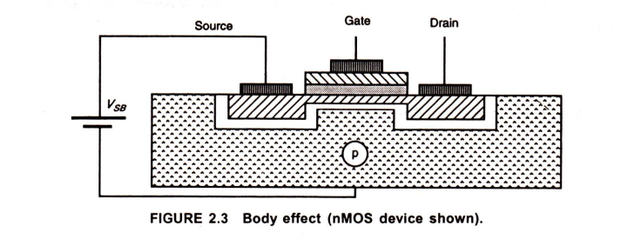

Aspects of MOS Transistor THRESHOLD VOLTAGE Vt
Body effects
Body bias is used to dynamically adjust the threshold voltage (V_{t}) of a CMOS transistor. ... Because the voltage difference between the source voltage (V_{s}) and body voltage (V_{b}) affects the V_{t}, the body can be thought of as a second gate that helps determine how a transistor turns on and off.
The body effects may also be considered since the substrate may be biased with respect to the source, as shown in Figure 2.3 .
Increasing Vs8 causes the channel to be depleted of charge carriers and thus the threshold voltage is raised.
Change in Vt is given by
where gamma is a constant which depends on substrate doping so that the more lightly doped the substrate, the smaller will be the body effect.

Slide 9

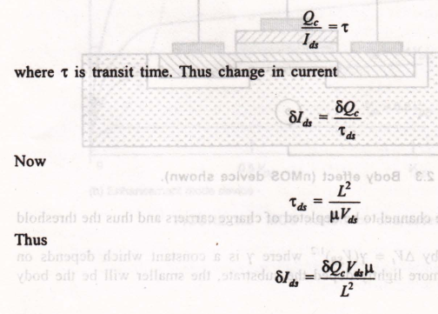
MOS Transistor Transconductance gm, and Output Conductance gds.
Transconductance gm
Transconductance expresses the relationship between output current Ids and the input voltage V gs and is defined as
To find an expression for g,. in terms of circuit and transistor parameters, consider that the charge in channel Qc is such that

Slide 10
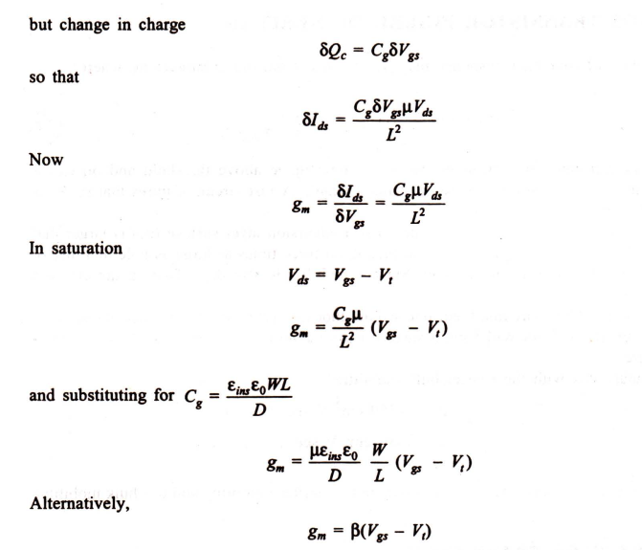
MOS Transistor Transconductance gm, and Output Conductance gds.

Slide 11
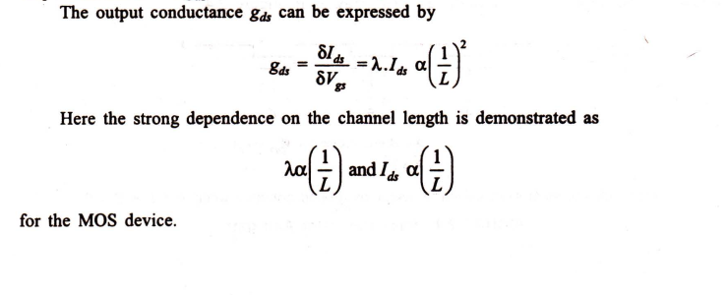
MOS Transistor Transconductance gm, and Output Conductance gds.
It is possible to increase the gm, of a MOS device by increasing its width.
However, this will also increase the input capacitance and area occupied.
A reduction in the channel length results in an increase in ω0 owing to the higher gm.
However,
The gain of the MOS device decreases owing to the strong degradation of the output resistance = 1/gds·

Slide 12
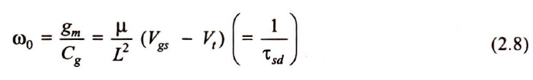
MOS Transistor Figure of Merit
An indication of frequency response may be obtained from the parameter ωo where
This shows that switching speed depends on gate voltage above threshold
&
on carrier mobility and inversely as the square of channel length.
A fast circuit requires that gm be as high as possible.
Electron mobility on a (100) oriented n-type inversion layer surface (un) is larger than that on a (111) oriented surface,
&
is in fact about three times as large as hole mobility on a (111) oriented p-type inversion layer.
Surface mobility is also dependent on the effective gate voltage (Vgs - V1).

Slide 13

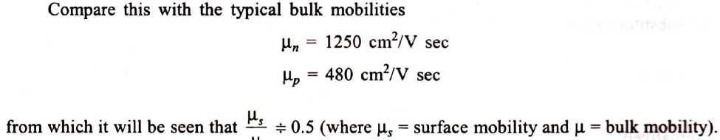
MOS Transistor Figure of Merit
For faster nMOS circuits, then, one would choose a (100) oriented p-type substrate in which the inversion layer will have a surface carrier mobility sec at room temperature.

Slide 14
Technology Scaling Motivation
The demand for battery-operated portable gadgets have increased day by day with tons of applications including hearing aids, cellular phone, laptops etc.
The “basic requirements” of such an application are less area, lower power consumption and cheaper development.
For such portable devices, power dissipation is important because the power provided by the battery is rather limited. Unfortunately, battery technologies cannot be expected to improve the battery storage capacity by more than 30% every five years. This is not sufficient to handle the increasing power needed in portable devices.

Slide 15
Scaling and Technology Node
By making transistors smaller, more circuits can be fabricated on the silicon wafer and therefore, the circuit becomes cheaper.
The reduction in channel length enables faster switching operations since less time is needed for the current to flow from drain to source.
In other words, a smaller transistor leads to smaller capacitance. This causes a reduction in transistor delay.
As dynamic power is proportional to capacitance, the power consumption also reduces. This reduction of transistor size is called scaling.
Each time a transistor is scaled, we say a new technology node has been introduced. The minimum channel length of transistor is called the technology node. For example, 0.18 micrometer, 0.13 micrometer, 90 nanometer etc.
The scaling improves cost, performance and power consumption with every new generation of technology.

Slide 16
Effects of Scaling/Small Dimension
For long channel devices, “edge effects” along the four sides of the channel are negligible. For long channel devices, the electric field lines are everywhere perpendicular to the surface of the channel. These electric fields are controlled by gate voltage and back gate voltage.
But, for short channel devices, the drain and source structure are closer to the channel, especially when the longitudinal electric field in the channel comes into picture.
The longitudinal electric field is controlled by drain-source voltage. The longitudinal electric field is parallel to the current flow direction. The device is called short channel device if channel length is not much larger than the sum of source and drain depletion widths.

Slide 17
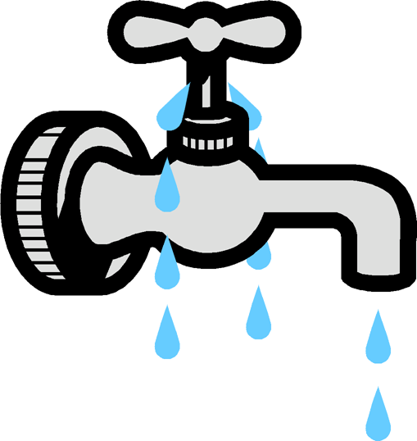
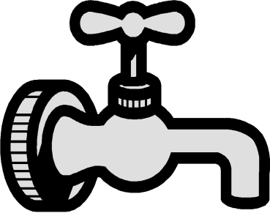
Problem Discussion
Issues for Scaling L_{g} to <25 nm
L_{g}
T_{ox}
V_{T} variation (statistical dopant fluctuations)
Leakage
Gate
Source
X_{j}
Drain
L_{eff}
Substrate
N_{sub}
G
S
Incommensurate gains in Idsat with scaling
limited carrier mobilities
parasitic resistance
D
Desired characteristics:
- High ON current (Idsat)
- Low OFF current

Slide 18
SELF-ASSESSMENT QUESTIONS
1. Which of the following is FALSE for a CMOS Transmission Gate?
It has one NMOS and one PMOS connected in Parallel
Control input is connected to get of NMOS and completed of the control input to get of PMOS
It has one NMOS and one PMOS connected in series.
It works as a controlled electronic switch.
As compared to other members of the logic family, power dissipation of CMOS is:
Zero
Extremely Low
Extremely High
Moderate

Slide 19
TERMINAL QUESTIONS
Define threshold voltage? Drive the Vt equation for MOS transistor.
Explain with neat diagrams the various NMOS fabrication technology.
Draw and explain BiCMOS inverter circuit.
Discuss the Basic Electrical Properties of MOS and BiCMOS Circuits.
Derive the expression for estimation of Pull-Up to Pull-Down ratio of an n-MOS inverter driven by another n-MOS inverter.

Slide 20
REFERENCES FOR FURTHER LEARNING OF THE SESSION
Reference Books:
1. Sung-Mo Kong, Yusuf Leblebici, “CMOS Digital Integrated Circuits Analysis and Design” Third Edition.
2. Debaprasad Das, “CMOS DESIGN” Second Edition.

Slide 21
THANK YOU
Team – VLSI DESIGN

